Slide 1

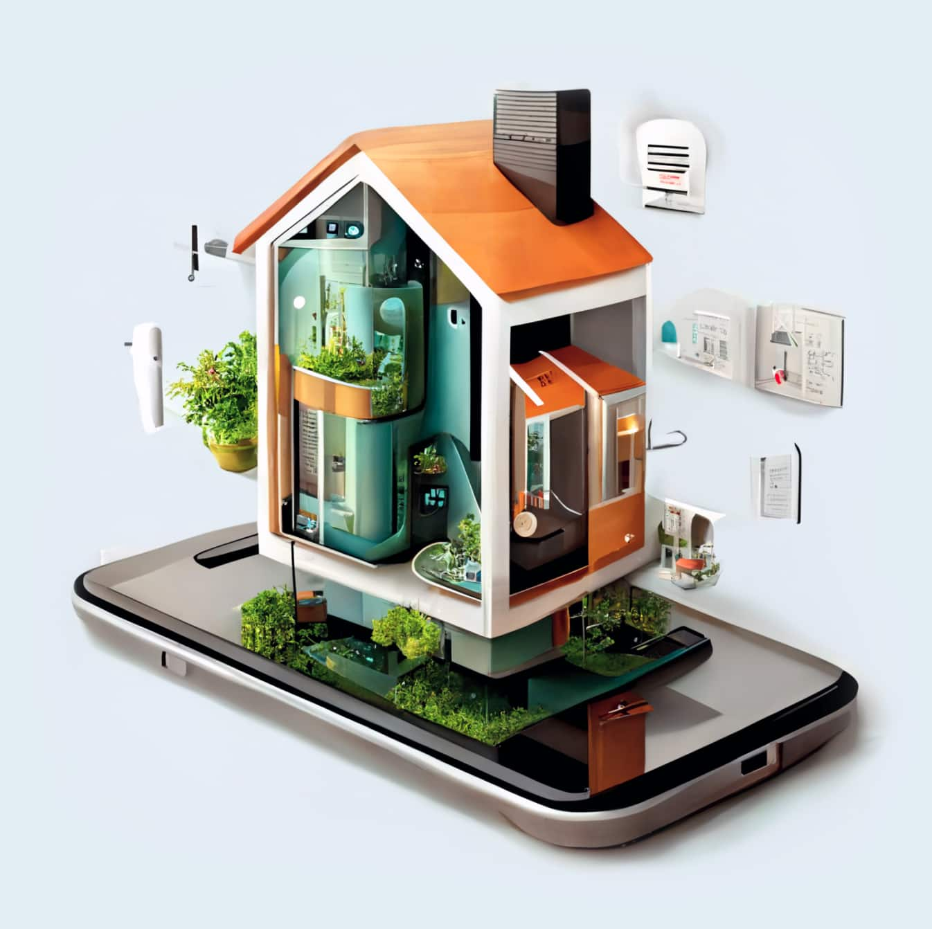

SMART HOME SYSTEM
Internet of Things and Big Data Analytics – IT4021
Group ID - 2024_12

Slide 2


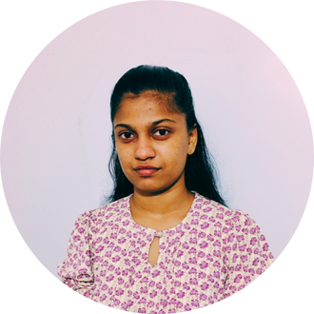




Our Team Members
Sewwandi W.M.C
Gangoda G.G.W.N
Purnamal M.C.P
Munasinghe M.G.P
IT20298494
IT20916626
IT20655334
IT20667450

Slide 3

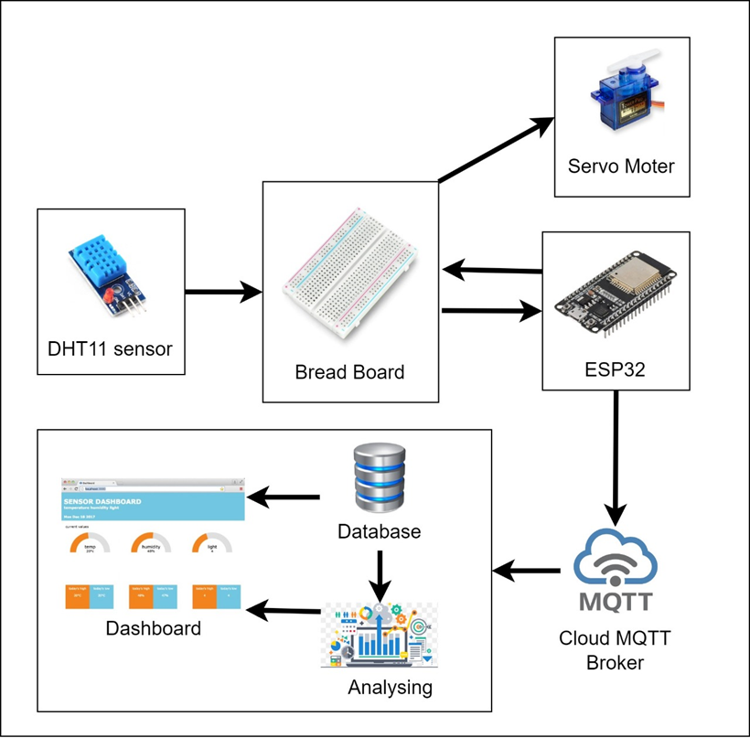

Introduction
Our project focuses on an IoT system that manages inside temperature depending on the Heat Index by manipulating the windows automatically.
The current Heat Index as well as the relative humidity for the past 12 months and the relative humidity for 12 months

Slide 4

Weekly Progress
Team worked on gathering the required knowledge on IoT devices and technologies such as the usage of DHT11, SG90 Servo motor, Node-red and ARIMA model.
01
Hardware components were checked, and the initial steps were taken to implement the system and assemble the hardware.
02
03
Utilized to set up the Node red, build the model and configure the actuators.
We were able to integrate all the hardware components as well as the model and finalize the project and tested and upgraded the product.
04

Slide 5
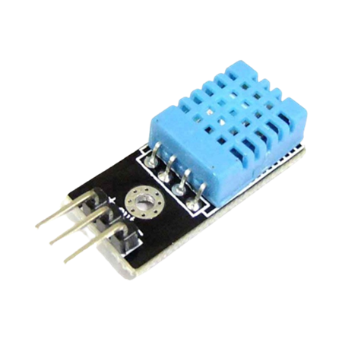

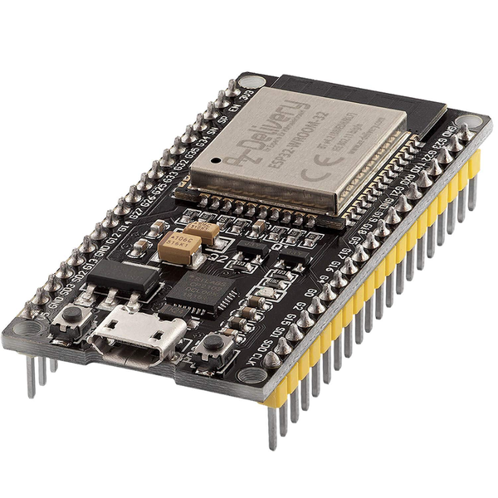
Hardware Implementation
DHT11 Sensor: Used to monitor the Temperature and Humidity in the current environment.
SG90 Servo motor (actuator): Used to display the heat index readings on a circular display by setting the motor's angle according to the relevant category of heat index.
ESP 32: Used as the controller for this project.

Slide 6
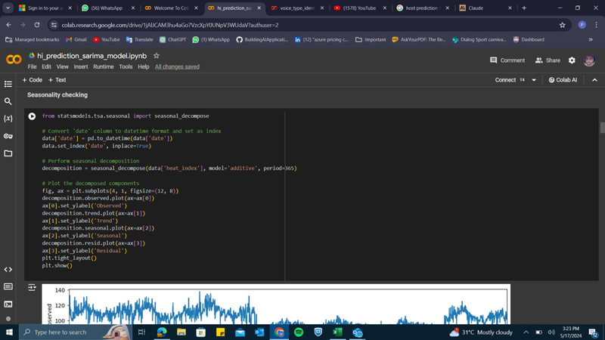
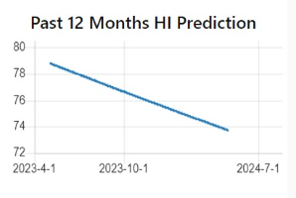
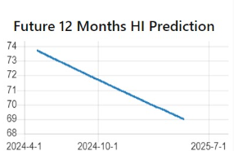
Model creation and
prediction
Preprocessed the dataset by cleaning, transforming and checking for stationarity.
Predicted the past 12 months and next 12 months' readings using ARIMA model.

Slide 7
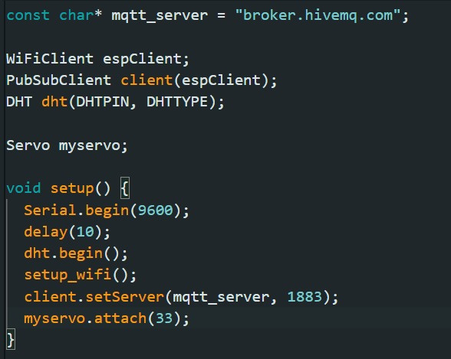

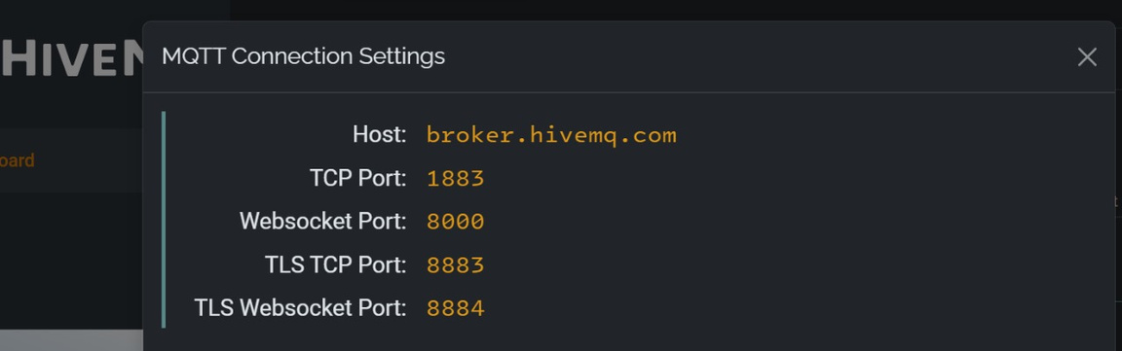

MQTT Implementation
MQTT (Message Queuing Telemetry Transport) used to send sensor readings to Hive MQ cloud.
Node-RED integrated with Hive MQ cloud using MQTT protocol to fetch data and display it on a dashboard.
MQTT is a lightweight, publish-subscribe network protocol ideal for IoT applications.

Slide 8
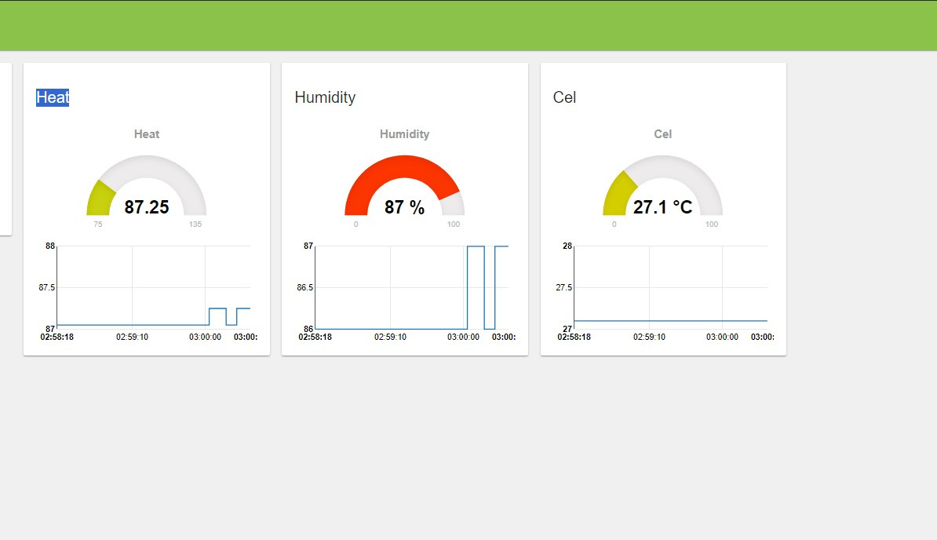
Dashboard Implementation
Three flows were created in Node-RED for the current, future and past prediction value dashboard displaying.
Then the current temperature, relative humidity and heat index was displayed using a gauge in the Node-red Dashboard.
The past and the future predictions are displayed using a linear graph.

Slide 9
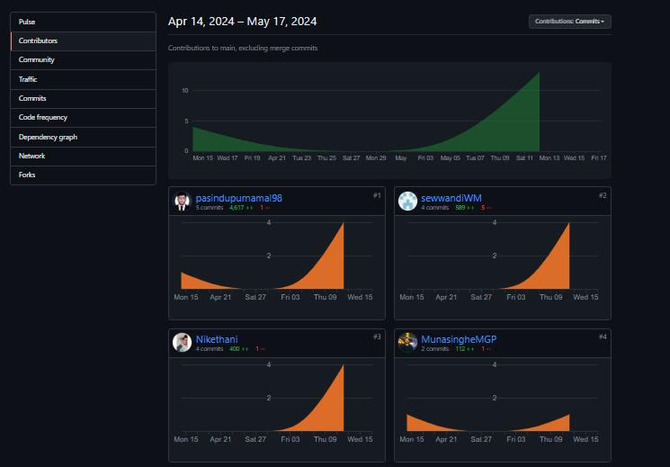

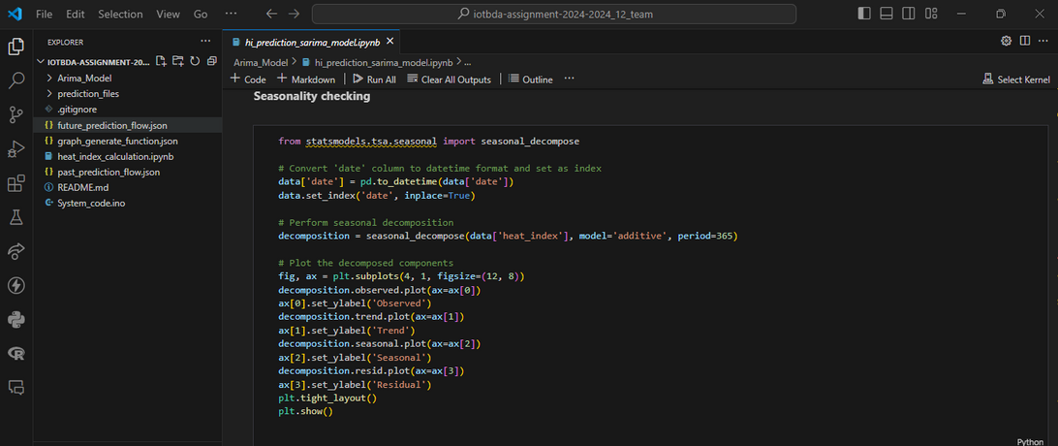

Good code quality and version controlling
Version controlling: All members contributed to the git repository. All developments were committed and pushed to the repository.
Code quality: VS Code was utilized. Proper comments, indentations, and code quality maintained.

Slide 10



THANK YOU

